Slide 1





NM1051 – SERVICENOW ADMINISTRATOR – SMART INTERNZ
OPTIMIZING USER, GROUP, AND ROLE MANAGEMENT WITH ACCESS CONTROL AND WORKFLOWS
A PROJECT REPORT
Submitted by
SANJAY S | (815422243022)
YOGESHWARAN K | (815422243030)
ROHITHA R | (815422243019)
KANIGA R | (815422243008)
VISHNUPRIYA C | (815422243029)
BACHELOR OF TECHNOLOGY
IN SEVENTH SEMESTER
ARTIFICIAL INTELLIGENCE AND DATA SCIENCE
SRI RAMAKRISHNA COLLEGE OF ENGINEERING
ANNA UNIVERSITY : CHENNAI 600 025
NOV/DEC 2025

Slide 2
ANNA UNIVERSITY : CHENNAI 600 025
BONAFIDE CERTIFICATE
Certified that this project report “OPTIMIZING USER, GROUP, AND ROLE MANAGEMENT WITH ACCESS CONTROL AND WORKFLOWS” is the bonafide work of “SANJAY S, YOGESHWARAN K, ROHITHAA R , KANIGA R, VISHNUPRIYA C” who
carried out the project work under my supervision. No part of the dissertation has been submitted for any degree or any other academic award anywhere before.
SIGNATURE Mrs. A.REETA JOLDRINE M.E., ASSISTANT PROFESSOR Department of AI&DS Sri Ramakrishna College of Engineering Perambalur | SIGNATURE Mr. S.SIVABALAN M.E., HEAD OF THE DEPARTMENT Department of AI&DS Sri Ramakrishna College of Engineering Perambalur
Submitted for the University Practical Examination held on……………….
INTERNAL EXAMINER
EXTERNAL EXAMINER

Slide 3
ProblemContext:
In a smallproject environment, aProject Manager(Alice) and aTeamMember (Bob) areresponsible for deliveringtasks. However,theabsence ofwell-defined roles, access restrictions, and structured workflows often creates confusion in responsibilities, accountability, and progress monitoring.
Objectives:
RoleDefinition: ClearlyoutlinethedutiesofAliceasProject ManagerandBobasTeam Member, ensuring both responsibility and access boundaries are transparent.
AccessControl: Introducemechanismsthat limit Bob’sabilityto createoredit projects beyond hisassigned tasks, while stillallowing himto view and update hisresponsibilities.
WorkflowOrganization: Establishastructuredprocessthat enablesAliceto assignwork, track task progress, and oversee completion in a timely and efficient manner

Slide 4
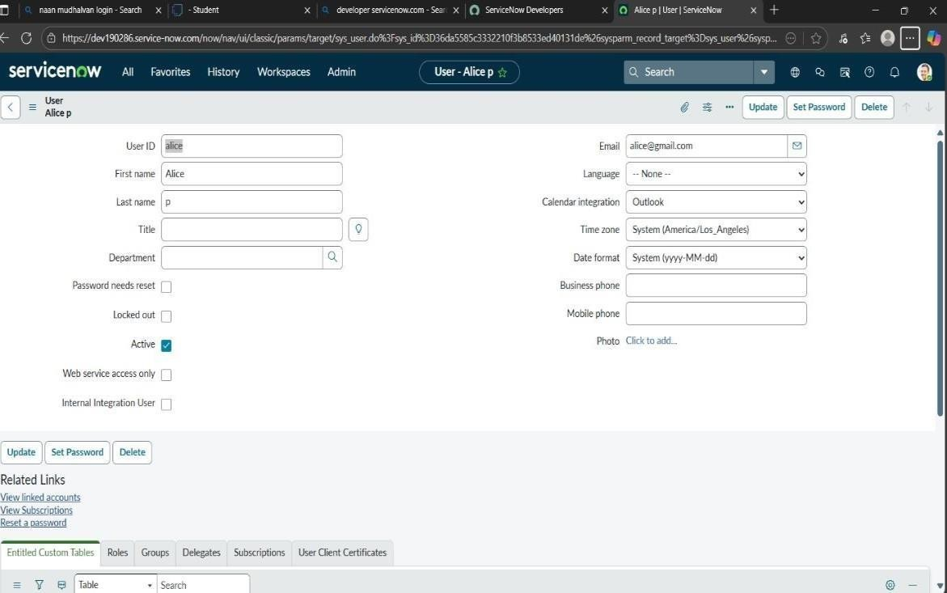
KeySkills/Tools:Users,Groups,Roles,Tables,AccessControlLists(ACL),Workflow/Flow Designer.
TASKINITIATION
Milestone1:Users
Activity1:CreateUsers
Openservicenow
ClickonAll>>search forusers
SelectUsersunder systemsecurity
Click onnew
Fillthefollowingdetailsto createanewuser
Click onsubmit

Slide 5
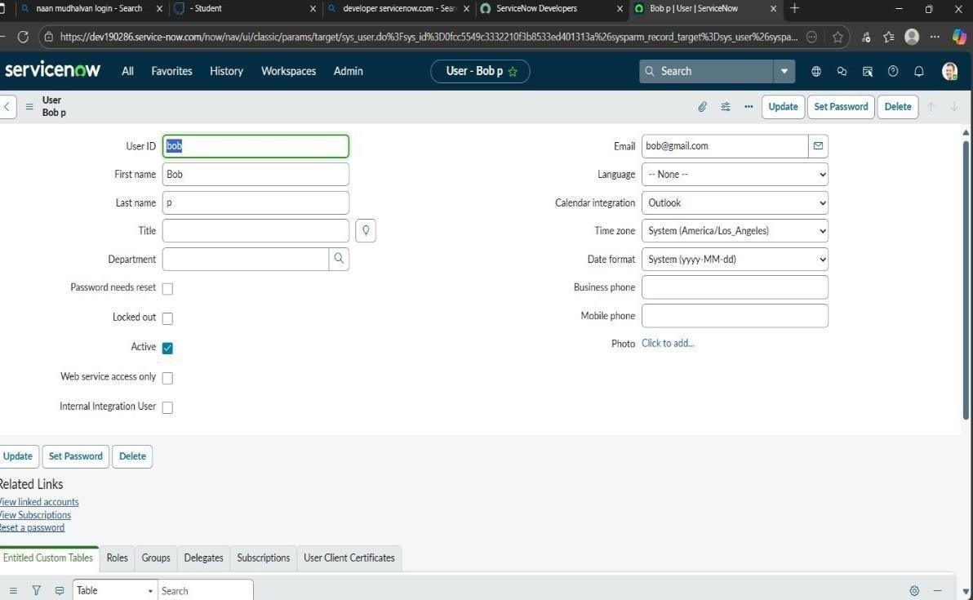
Createonemoreuser:
Createanotheruserwiththefollowingdetails
Click onsubmit
Milestone 2: Groups
Activity1:CreateGroups
Openservicenow.
ClickonAll>>search forgroups
Selectgroupsundersystemsecurity
Click onnew
Fillthefollowingdetailsto createanewgroup
Click onsubmit.

Slide 6
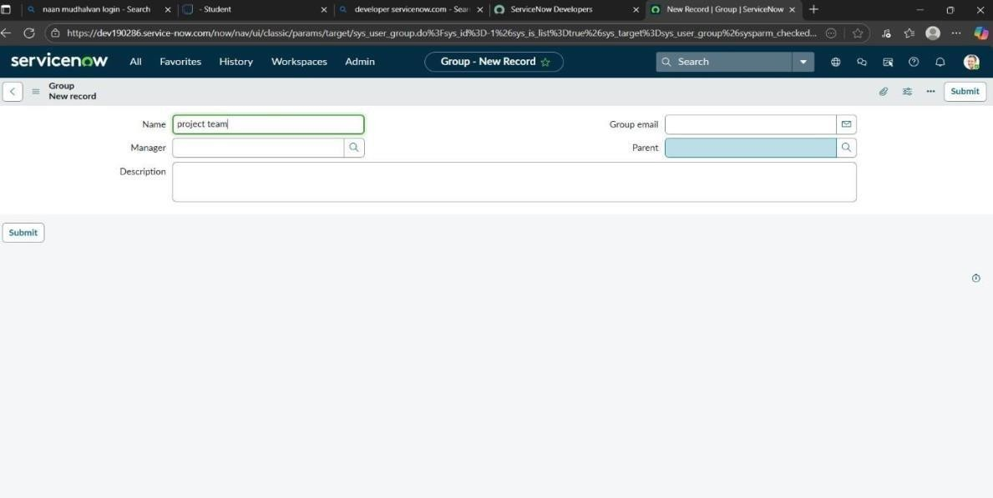
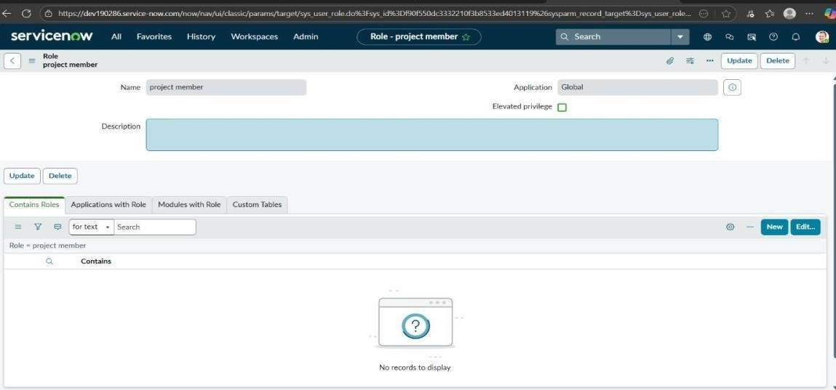
Milestone 3: Roles
Activity1:Createroles
Openservicenow.
ClickonAll>>search forroles
Selectrolesundersystemsecurity
Click onnew
Fillthefollowingdetailstocreateanewrole
Click onsubmit.

Slide 7
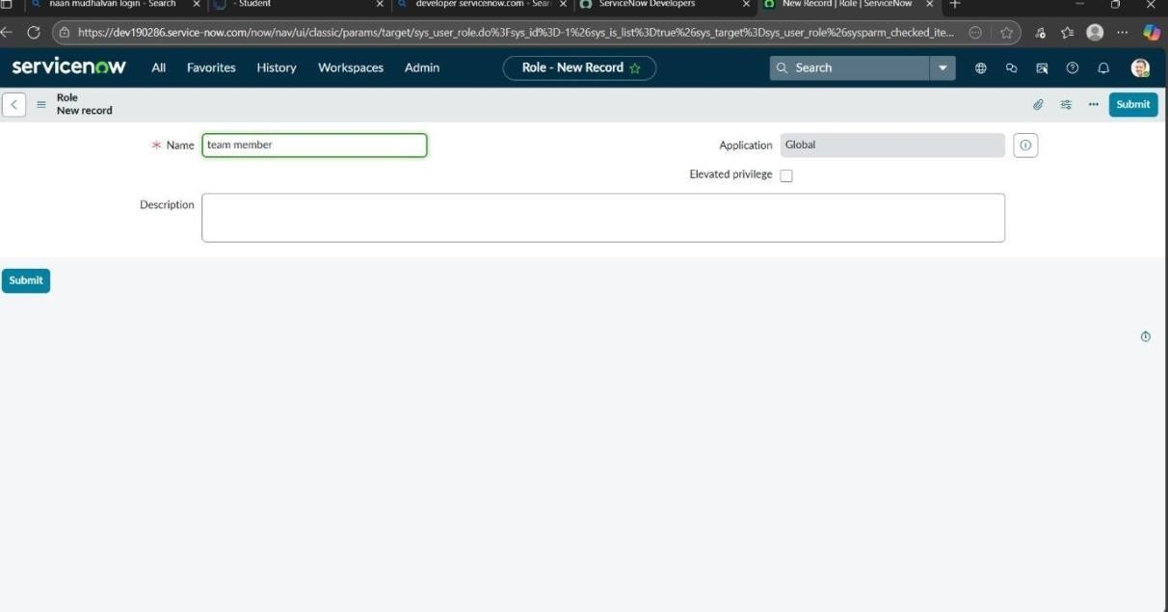
Createonemorerole:
Createanotherrolewiththefollowingdetails
Click onsubmit
Milestone 4: Table
Activity1:CreateTable
Openservicenow.
ClickonAll>>search fortables
Selecttablesunder systemdefinition
Click onnew
Fillthefollowingdetailstocreateanewtable Label: project table
ChecktheboxesCreatemodule &Createmobilemodule
Undernew menuname:projecttable
Undertablecolumnsgivethecolumns

Slide 8
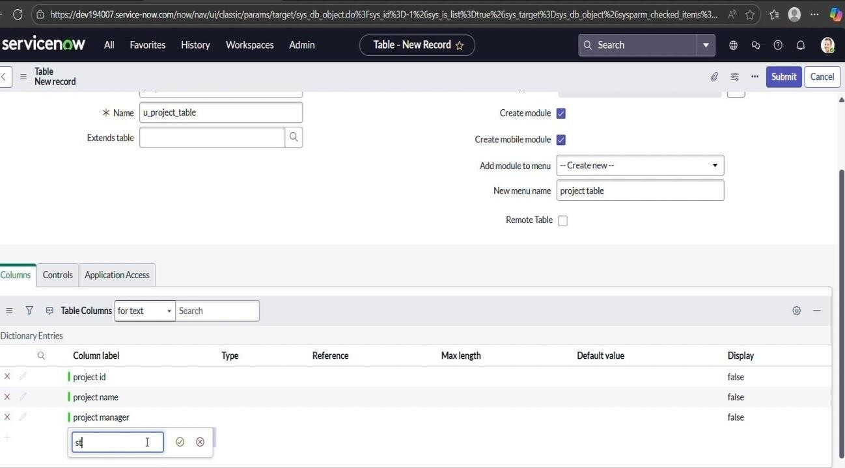
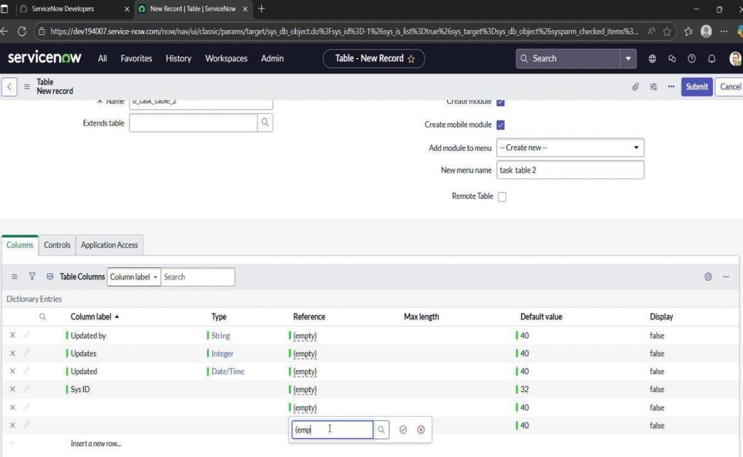
8. Click onsubmit

Slide 9
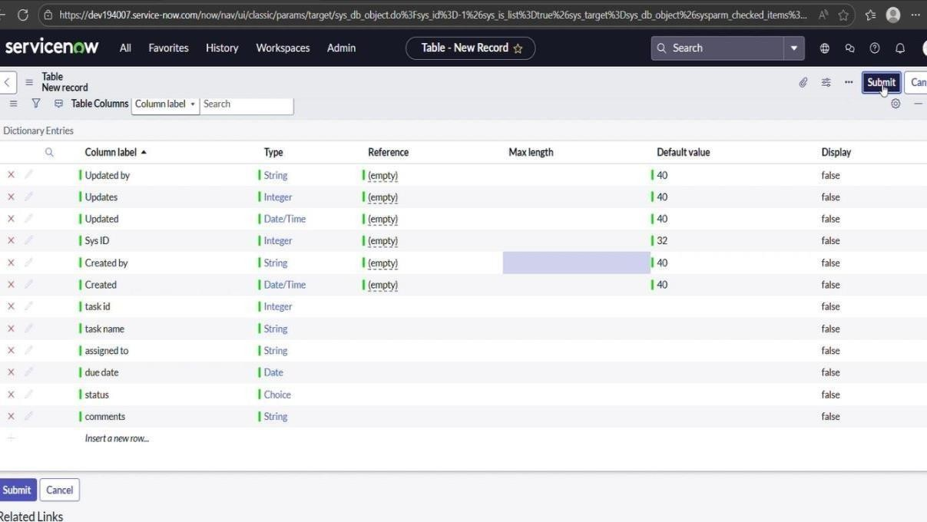
Createonemoretable:
Createanothertableas:tasktable2andfillwithfollowingdetails.
Clickonsubmit.
Milestone5:Assignuserstogroups
Activity1:Assignuserstoprojectteamgroup
Openservicenow.
ClickonAll>>search forgroups
Selecttablesunder systemdefinition
Selecttheprojectteamgroup
Undergroupmembers
Clickonedit
Selectalicepandbobpandsave

Slide 10
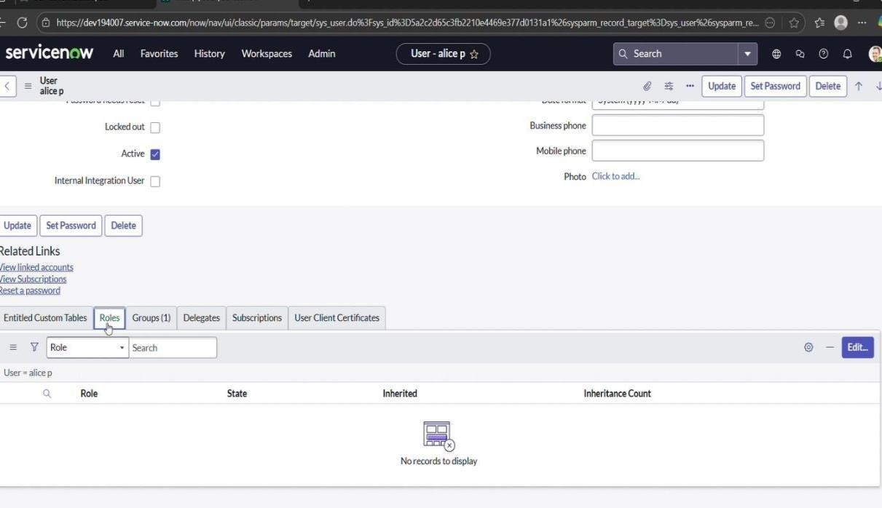
Milestone 6: Assign roles to users
Activity1:Assignrolestoaliceuser
Openservicenow.ClickonAll>>searchforuser
Selecttablesunder systemdefinition
Selecttheproject manageruser
Underprojectmanager
Clickonedit
Selectprojectmemberandsave
clickoneditaddu_project_tableroleandu_task_tablerole
clickonsaveandupdatetheform.

Slide 11
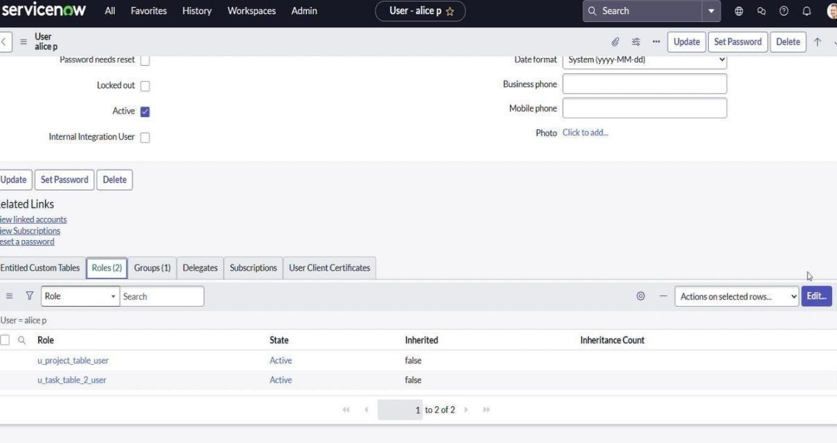
Activity2:Assignrolestobobuser
Openservicenow.ClickonAll>>searchforuser
Selecttablesunder systemdefinition
Selectthebobp user
Underteammember
Clickonedit
Selectteammemberandgivetableroleandsave
ClickonprofileiconImpersonate usertobob
We cansee the tasktable2.

Slide 12
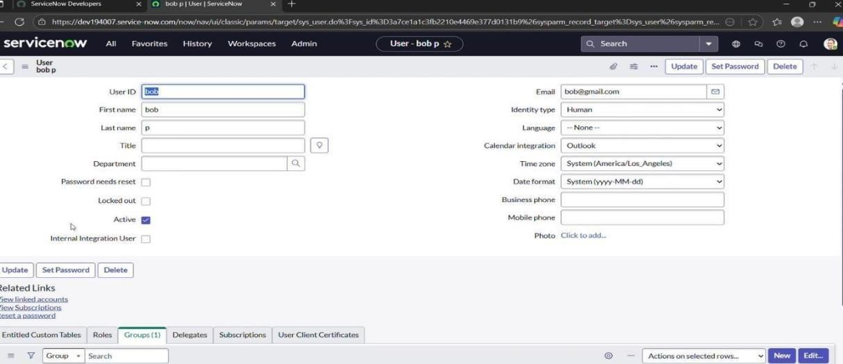
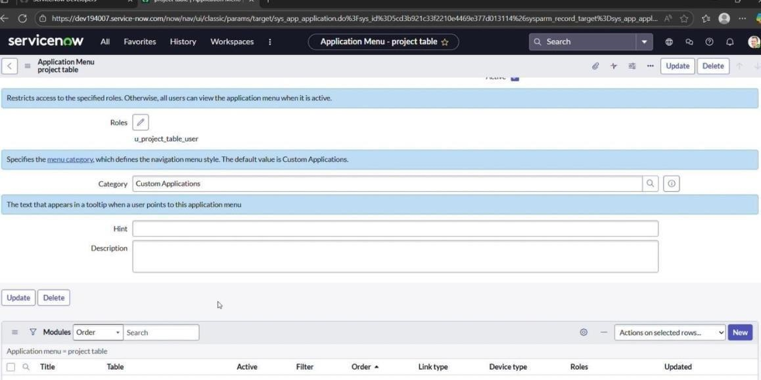
Milestone7:Applicationaccess
Activity1:Assigntableaccesstoapplication
whilecreatingatableitautomaticallycreateapplicationandmoduleforthattable
Gotoapplicationnavigatorsearchforsearchprojecttableapplication
Clickoneditmodule
Giveprojectmemberrolestothatapplication
Searchfortasktable2and click oneditapplication.
Givetheprojectmemberandteammemberrolefortasktable2 application

Slide 13
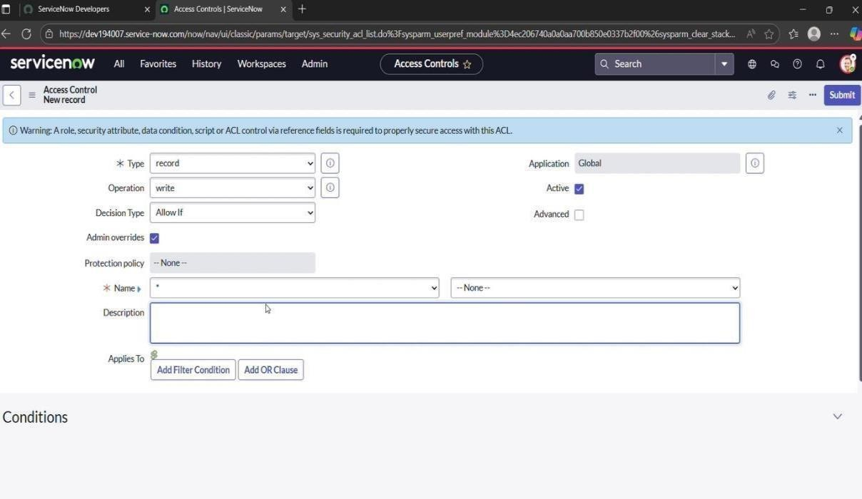
Milestone8:Accesscontrollist Activity
1: Create ACL
Openservicenow.
ClickonAll>>search forACL
SelectAccessControl(ACL) undersystemsecurity
Clickonelevaterole
Click onnew
Fillthefollowingdetailsto createanewACL
Scrolldownunderrequiresrole
Doubleclickoninsertanewrow
Givetasktableandteammemberrole
Clickonsubmit
Similarlycreate4 aclforthefollowingfields
Clickonprofile ontoprightside

Slide 14
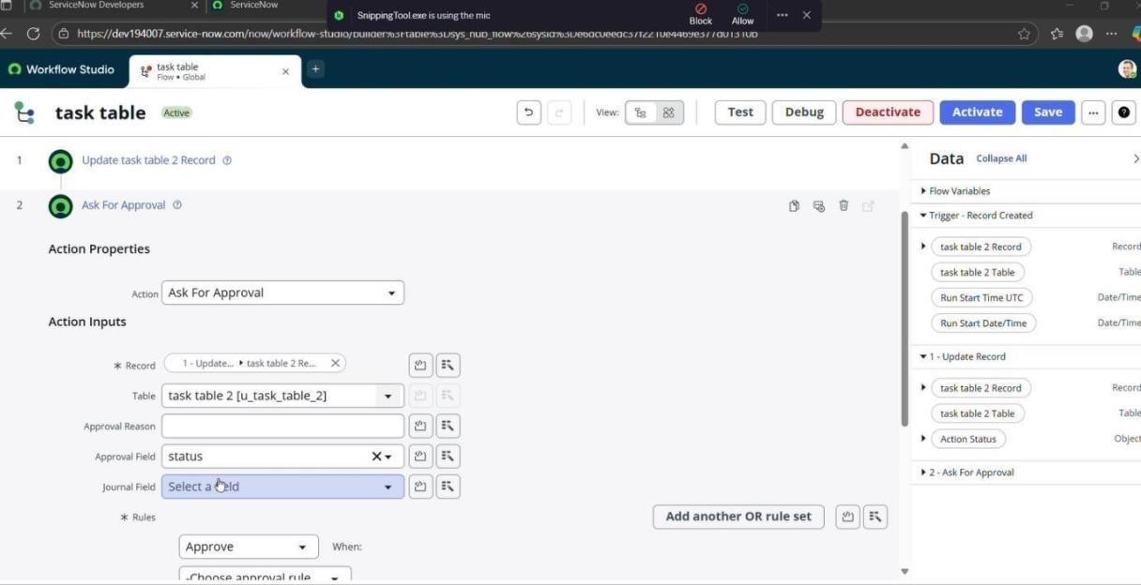
Clickonimpersonateuser
Select bobuser
Gotoallandselecttasktable2intheapplication menubar
Commentandstatusfields havetheeditaccess
Milestone9:Flow Activity1:CreateaFlowtoAssignoperationstickettogroup
Openservicenow.
Click onAll>>searchforFlow Designer
ClickonFlowDesignerunderProcessAutomation.
AfteropeningFlowDesignerClickonnewandselectFlow.
UnderFlowpropertiesGiveFlowNameas “tasktable”.
ApplicationshouldbeGlobal.
Clickbuildflow.
nextstep:
1. Click onAdda trigger

Slide 15
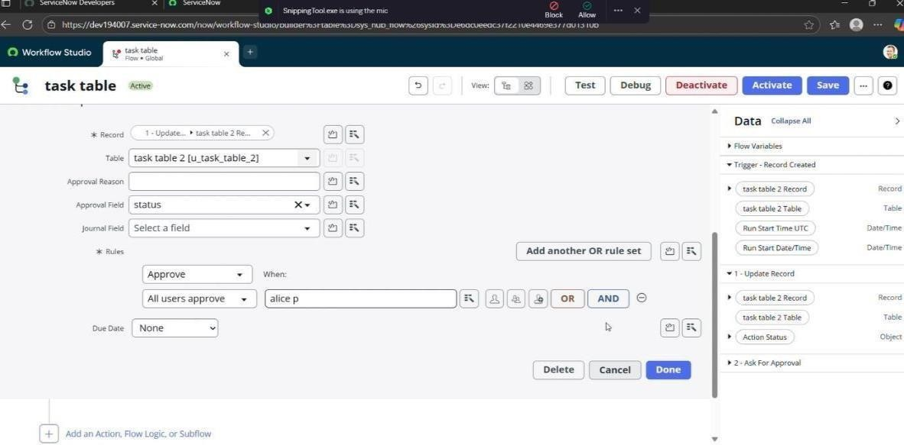
SelectthetriggerinthatSearchfor“createrecord”andselectthat.
Givethetablenameas“tasktable”.
GivetheConditionasField:statusOperator:isValue:inprogress
Field:commentsOperator:isValue:feedback Field: assigned to Operator: is Value: bob
AfterthatclickonDone.
Nextstep:
  ClickonAddanaction.
  Selectactioninthat,searchfor“updaterecords”.
  InRecordfield dragthefieldsfromthedatanavigation fromRightSide(Datapill)
  Tablewillbeautoassignedafterthat
  Addfieldsas“status”andvalueas“completed”
  Click onDone.

Slide 16
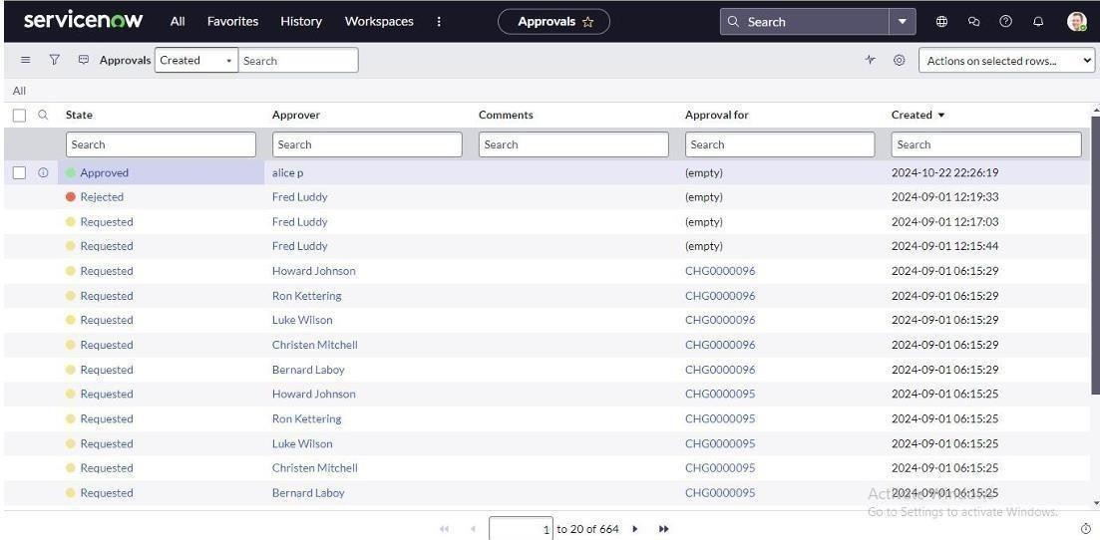
Nextstep:
NowunderActions.
ClickonAddanaction.
Selectactioninthat,searchfor“askforapproval”.
InRecordfield dragthefieldsfromthedatanavigationfromRightside
Tablewillbeautoassignedafterthat
Givetheapprovefieldas“status”
Giveapproverasalicep
Click onDone.
Gotoapplicationnavigatorsearchfortasktable.
Itstatusfieldisupdatedtocompleted
Gotoapplication navigatorandsearchfor myapproval
Clickonmyapprovalundertheservice desk.
Alicepgot approvalrequestthenrightclickonrequestedthenselectapproved

Slide 17
Conclusion:
This approachprovides a streamlined systemfor managing projects by defining roles, applying access restrictions, and organizing workflows. It helps the team collaborate effectively, improves accountability, simplifies task tracking, and ensures successful project delivery.

Slide 18
CERTIFICATE:

Slide 19
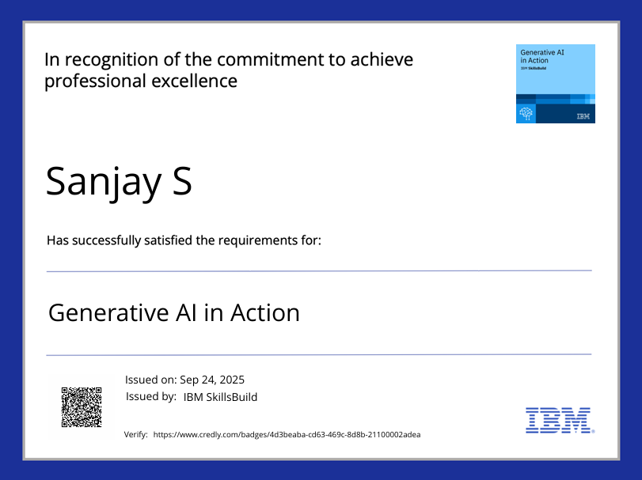

Slide 20
